Slide 1

Machine Learning-Based Plug-in Electric Vehicle Charging with Forecasted Price

Slide 2
Machine Learning-Based Plug-in Electric Vehicle Charging with Forecasted Price
By
Chanakya Chelamkuri (510818087)
Syed Sohail (510818075)
Kishore Nimmada (510818077)
Under supervision of
Prof. Indrajit Banerjee

Slide 3
BIRD-EYE VIEW OF THE PROJECT
1. Objective
2. Importance
3. What is Machine-Learning
4. Use of ML in our mini-project
5. Historical Input Dataset
6. Algorithms implemented
7. Results
8. Conclusion
9. Limitations
10. Future improvements

Slide 4
Objective
The goal of the proposed PEV(Plug-in Electric Vehicle) charging method is to decrease the cost of charging to a consumer over a long-term time horizon.
The main objective is to see how machine learning helps to find the best suitable charging station for the consumer.

Slide 5
Importance
The transportation system is one of the biggest contributors to the diminishing oil resources and environmental problems such as increasing level of pollution. In order to address these problems, plug-in electric vehicles (PEVs) will soon become an important component of the transportation system.
Uncontrolled PEV charging on the other hand, can lead to a significant increase of the residential electricity consumption cost for the PEV owner.
PEV charging outside of home might lead to further increase in costs. Smart PEV charging programs may take advantage of the electricity price variation and the flexibility of the load scheduling.

Slide 6
What is machine learning?
Machine learning (ML) is the study of computer algorithms that improve automatically through experience. Machine learning algorithms build a model based on sample data, known as “training data“, in order to make predictions or decisions without being explicitly programmed to do so.
Machine learning focuses on the development of computer programs that can access data and use it to learn for themselves.

Slide 7
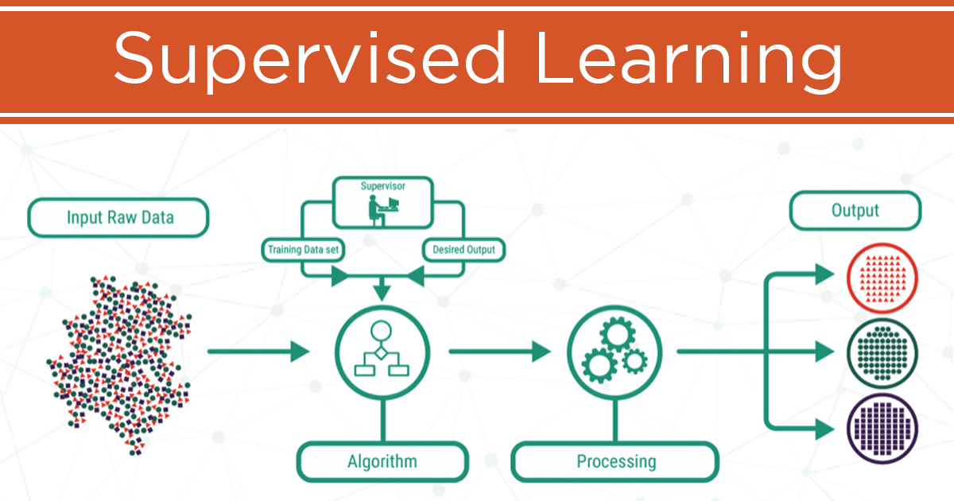
Types of machine learning
Supervised Learning: The computer is presented with example inputs and their desired outputs and the goal is to learn a general rule that maps inputs to outputs.

Slide 8
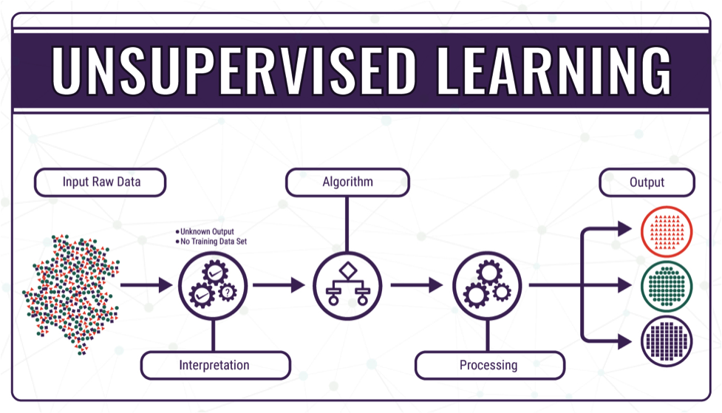
Types of machine learning
Unsupervised Learning: No labels are given to the learning algorithm, leaving it on its own to find structure in its input. Unsupervised learning can be a goal in itself .

Slide 9
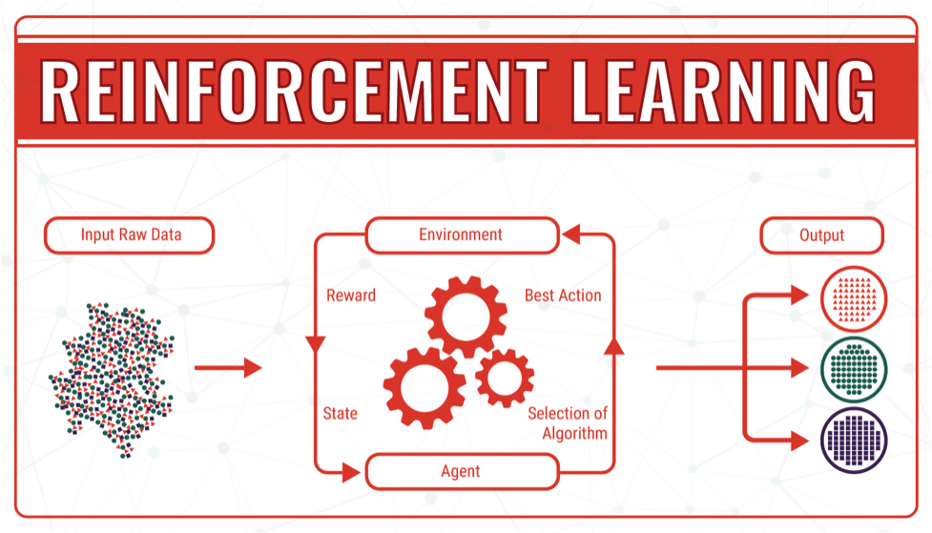
Types of machine learning
Reinforcement Learning: A computer program interacts with a dynamic environment in which it must perform a certain goal in order to maximize the notion of cumulative reward.

Slide 10
Use of ml in our project
Machine learning is used to build algorithms that can receive the input data and use statistical analysis to predict the output, based upon the type of data available.
In our Project we take use of algorithms based on supervised learning. We used historical dataset to train the algorithms using classification models.
Classification: Classification is the process of predicting the class of given data points. Classes are sometimes called as targets/ labels or categories. Classification predictive modeling is the task of approximating a mapping function (f) from input variables (X) to discrete output variables (y).

Slide 11
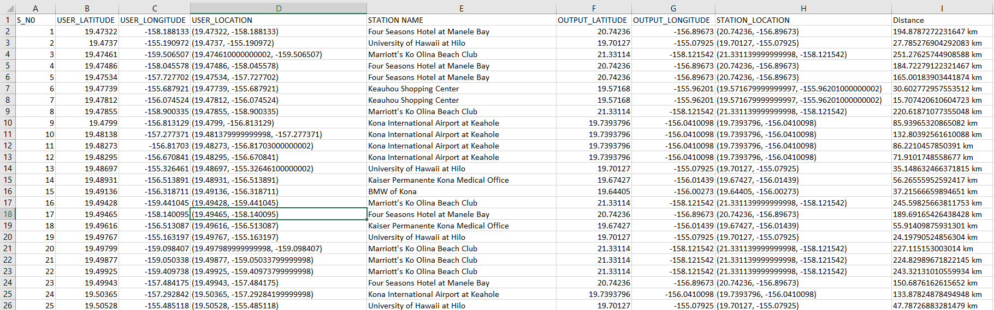
SAMPLE OF Historical input dataset
Source:1) https://data.world/state-of-hawaii/95x5-qrxh
2) https://opendata.hawaii.gov/dataset/hawaii-public-electric-vehicle-charging-stations/resource/71fe679d-85d4-4784-bd63-544ecaa71756

Slide 12
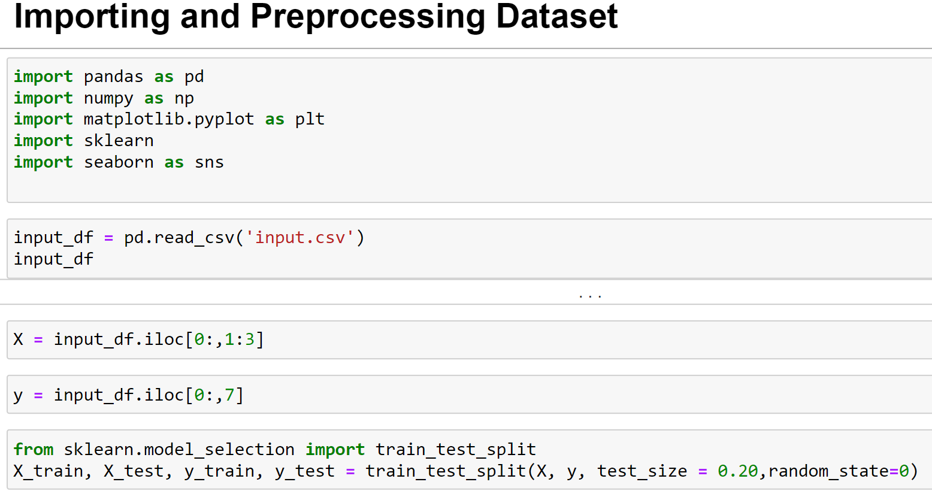

Slide 13
ALGORITHMS
In our Project we used mainly four algorithms they are:
Support vector machine (SVM)
Decision Tree
K-Nearest Neighbor (KNN)
Naive Bayes
The above algorithms make use of historical data available to predict output.

Slide 14
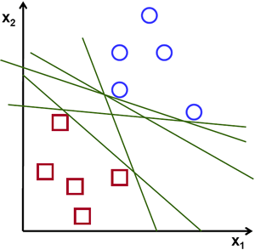
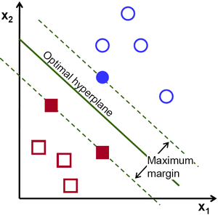
Support Vector Machine(SVM)
The objective of the support vector machine algorithm is to find a hyperplane in an N-dimensional space (N — the number of features) .
Hyperplanes are decision boundaries that help classify the data points. Data points falling on either side of the hyperplane can be attributed to different classes. Also, the dimension of the hyperplane depends upon the number of features.

Slide 15
ADVANTAGES
DISADVANTAGES
Effective in high dimensional spaces.
Still effective in cases where number of dimensions is greater than the number of samples.
Uses a subset of training points in the decision function (called support vectors), so it is also memory efficient.
Versatile: different kernel functions can be specified for the decision function. Common kernels are provided, but it is also possible to specify custom kernels.
If the number of features is much greater than the number of samples, avoid over-fitting in choosing kernel functions and regularization term is crucial.
SVMs do not directly provide probability estimates, these are calculated using an expensive five-fold cross-validation

Slide 16
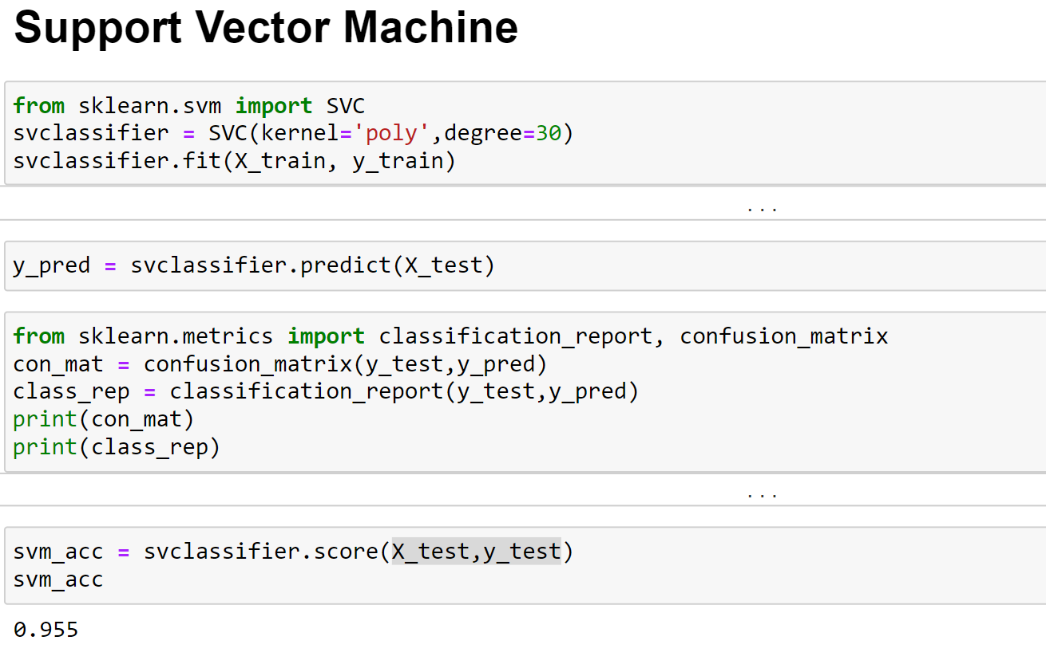
IMPLEMENTATION

Slide 17
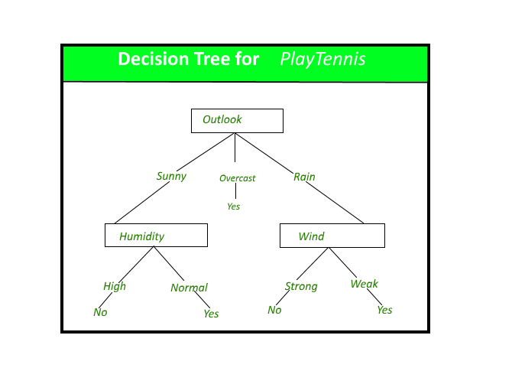
DECISION TREE
Decision tree is the most powerful and popular tool for classification and prediction. A Decision tree is a flowchart like tree structure, where each internal node denotes a test on an attribute, each branch represents an outcome of the test, and each leaf node (terminal node) holds a class label.

Slide 18
ADVANTAGES
disadvantages
Decision trees are able to generate understandable rules.
Decision trees perform classification without requiring much computation.
Decision trees are able to handle both continuous and categorical variables.
Decision trees provide a clear indication of which fields are most important for prediction or classification.
Decision trees are less appropriate for estimation tasks where the goal is to predict the value of a continuous attribute.
Decision trees are prone to errors in classification problems with many class and relatively small number of training examples.
Decision tree can be computationally expensive to train. The process of growing a decision tree is computationally expensive. At each node, each candidate splitting field must be sorted before its best split can be found.

Slide 19
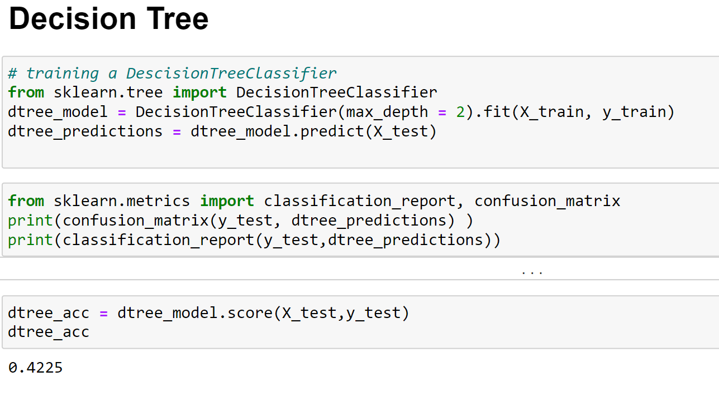
IMPLEMENTATION

Slide 20
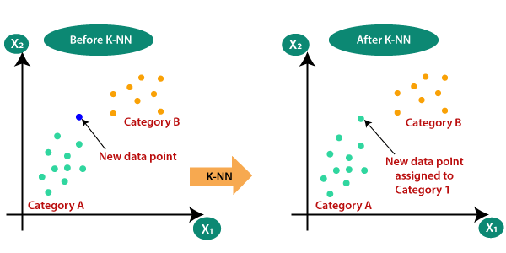
K-Nearest neighbour
K-NN algorithm assumes the similarity between the new case/data and available cases and put the new case into the category that is most similar to the available categories.
K-NN algorithm stores all the available data and classifies a new data point based on the similarity. This means when new data appears then it can be easily classified into a well suite category by using K- NN algorithm.

Slide 21
ADVANTAGES
DISADVANTAGES
It is simple to implement.
It is robust to the noisy training data
It can be more effective if the training data is large.
Always needs to determine the value of K which may be complex some time.
The computation cost is high because of calculating the distance between the data points for all the training samples.

Slide 22
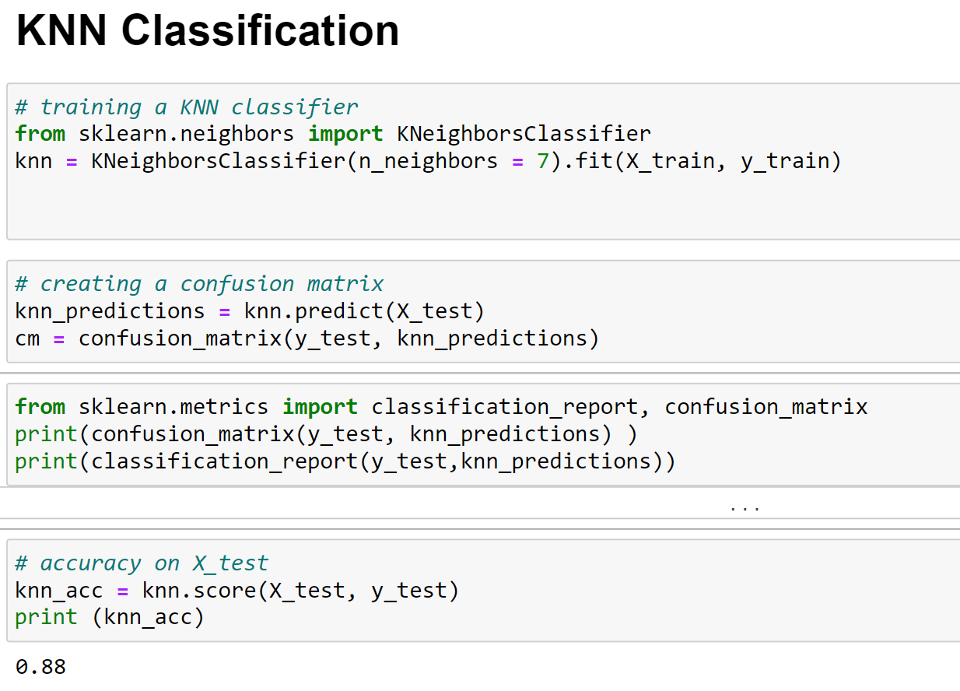
IMPLEMENTATION

Slide 23

Naïve Bayes Classifier Algorithm
Naïve Bayes algorithm is a supervised learning algorithm, which is based on Bayes theorem and used for solving classification problems.
It is a probabilistic classifier, which means it predicts on the basis of the probability of an object.
Bayes' Theorem:
Bayes' theorem is also known as Bayes' Rule or Bayes' law, which is used to determine the probability of a hypothesis with prior knowledge. It depends on the conditional probability.
The formula for Bayes' theorem is given as:
Gaussian: It is used in classification and it assumes that features follow a normal distribution.

Slide 24
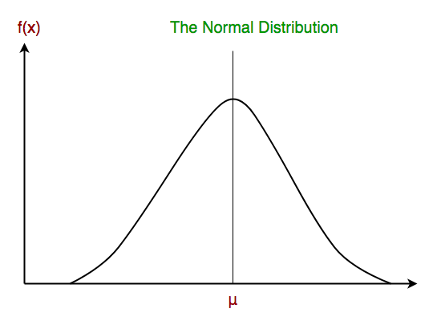
Gaussian Naive Bayes classifier
In Gaussian Naive Bayes, continuous values associated with each feature are assumed to be distributed according to a Gaussian distribution.

Slide 25
ADVANTAGES
DISADVANTAGES
This algorithm works quickly and can save a lot of time.
Naive Bayes is suitable for solving multi-class prediction problems.
If its assumption of the independence of features holds true, it can perform better than other models and requires much less training data.
Naive Bayes is better suited for categorical input variables than numerical variables.
Naive Bayes assumes that all predictors (or features) are independent, rarely happening in real life. This limits the applicability of this algorithm in real-world use cases.
This algorithm faces the ‘zero-frequency problem’ where it assigns zero probability to a categorical variable whose category in the test data set wasn’t available in the training dataset. It would be best if you used a smoothing technique to overcome this issue.
Its estimations can be wrong in some cases, so you shouldn’t take its probability outputs very seriously.

Slide 26
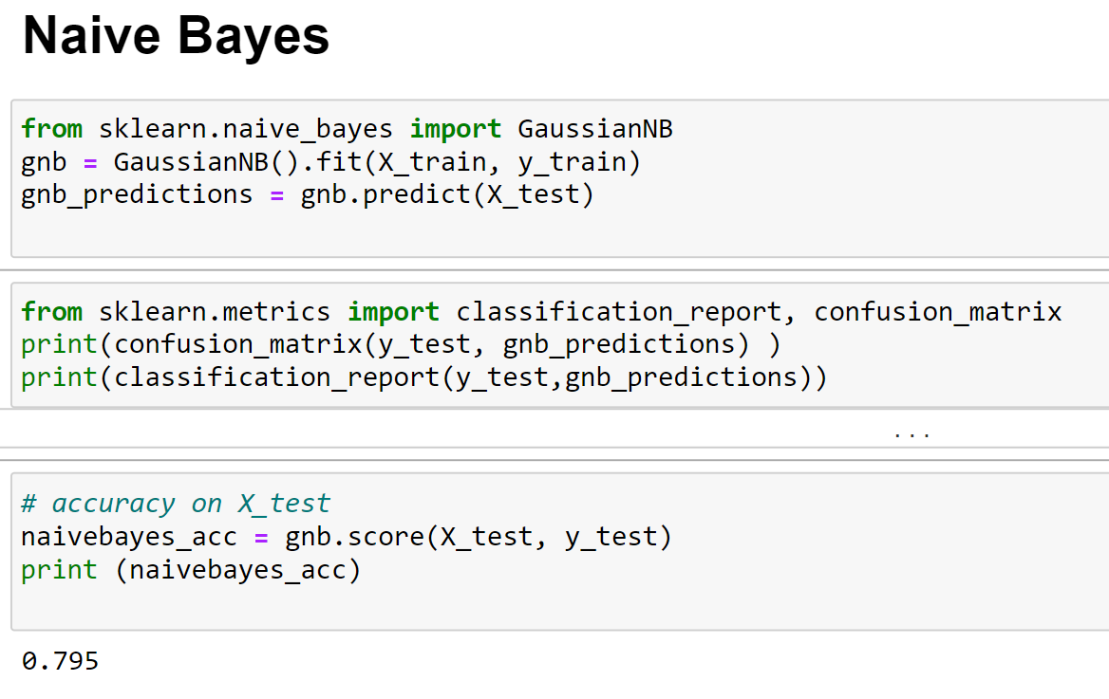
IMPLEMENTATION

Slide 27
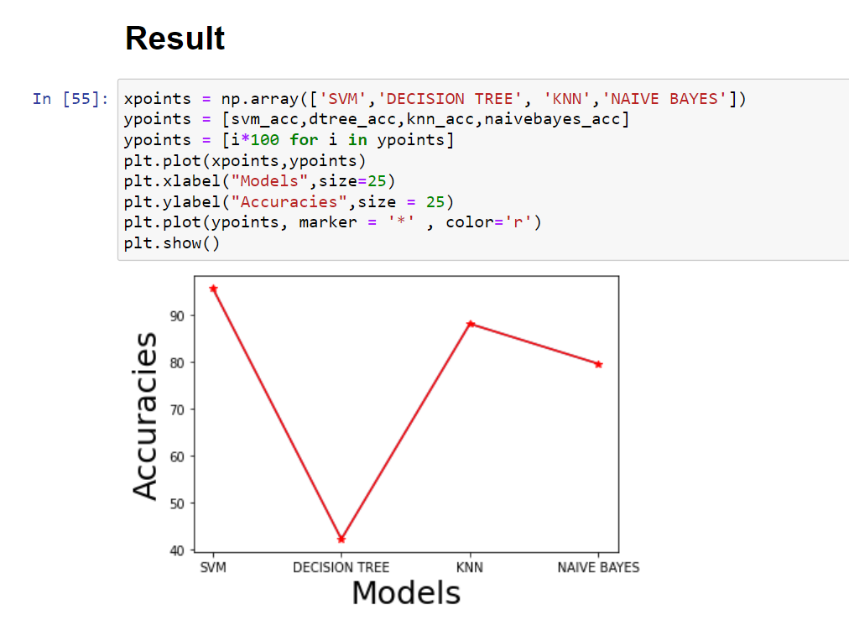

Slide 28
CONCLUSION
We have used four models to approach the problem statement in which SVM model gave the best results and KNN model gave noticeable result following SVM model.
Among the four models, Decision tree model has given the worst result.
All the four algorithmic model classifiers took similar amount of time to execute.
Hence, we can conclude that SVM classifier is best suited for our problem statement.

Slide 29
LIMITATIONS
We have considered equatorial distance between user and charging station instead of travelling distance.
We could have considered reinforcement learning model algorithms for the given problem statement.
Historical Input data that is available from the different sources is not sufficient to build a model which is more practical in the modern world.

Slide 30
FUTURE IMPROVEMENTS
We can consider GPS feature to the application and suggest the best possible charging station suitable for the consumer.
We can consider varying price feature by knowing the day-ahead electricity prices from the utility company.
We can consider some more features to get better practical results such as User Choice, Model of the Vehicle and Residual charge.
We can develop an application by considering all above features to reduce the charging cost of PEV in which we can take above features as input and suggest the user for the best possible charging station.

